Slide 1
ANALYSIS OF SEQUENTIAL CIRCUITS
Analyze the behavior of sequential system
  Step 1: get flip flop input equations
    Characteristic equation of flip flop
  Step 2: get state table and state diagram
  Step 3: get timing trace and timing diagram
Two different models
  Mealy model
    Outputs depends on the present input, as well as the state of the system.
  Moore model
    Outputs only depends on the state of the system.

Slide 2
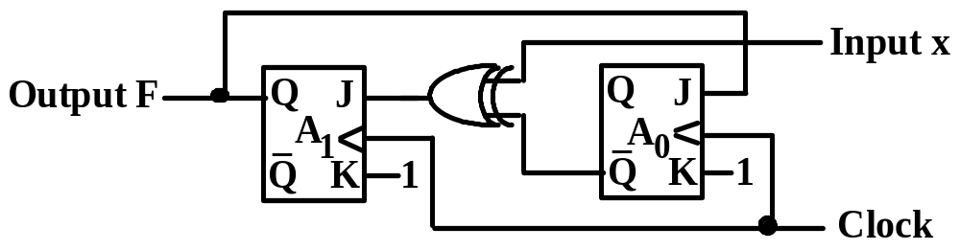
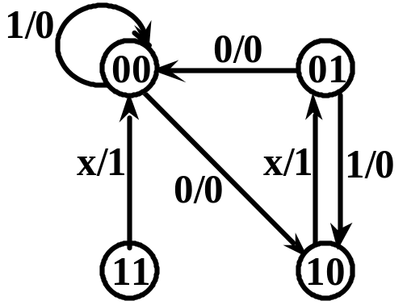
ANALYSIS OF SEQUENTIAL CIRCUITS
Write logical expressions for excitation and output in terms of input and current state.
Write state transition table and output table.
Draw the state transition diagram.
Example 4.1
J₁ = x + A₀
K₁ = 1
J₀ = A₁
K₀ = 1
F = A₁
current
next
x
0 0 0 01 1 1 1
A₁ A₀
0 0 0 1 1 0 1 1 0 0 0 1 1 0 1 1
J₁ K₁
1 1 0 1 1 1 0 1 0 1 1 1 0 1 1 1
J₀ K₀
0 1 0 1 1 1 1 1 0 1 0 1 1 1 1 1
A₁*
1 0 0 0 0 1 0 0
A₀*
0 0 1 0 0 0 1 0
F
0 0 1 10 0 1 1
When x=0,
00->10->01->00->…
When x=1,
01->10->01->…
Self-correcting:
x=0, 11->00
x=1, 11->00, 00->00

Slide 3
EX2: Mealy Model Circuit
x
•
•
•
z
•
D₁
Q₁
D₂
Q₂
Q₁’
Q₂’
Clock
•
D₁ = xQ₁ + xQ₂
D₂ = xQ₁’Q₂’
z = xQ₁
Flip flop input eQuations :

Slide 4
EX2: Mealy Model Circuit
D₁ = xQ₁ + xQ₂
D₂ = xQ₁’Q₂’
z = xQ₁
Q* = D
0/0
Q₁* = D₁ = xQ₁ + xQ₂
Q₂* = D₂ = xQ₁’Q₂’
z = xQ₁
0/0
00
11
0/0
1/1
1/0
0/0
01
10
 | Q₁*Q₂* |  | z
Q₁Q₂ | x = 0 | x = 1 | x = 0 | x = 1
0 0 | 0 0 | 0 1 | 0 | 0
0 1 | 0 0 | 1 0 | 0 | 0
1 0 | 0 0 | 1 0 | 0 | 1
1 1 | 0 0 | 1 0 | 0 | 1
1/0
1/1
Two output columns.
State 11 is never reached.
Output is not associated with the state but with the transition.

Slide 5
EX2: Mealy Model Circuit
 | Q₁*Q₂* |  | z
Q₁Q₂ | x = 0 | x = 1 | x = 0 | x = 1
0 0 | 0 0 | 0 1 | 0 | 0
0 1 | 0 0 | 1 0 | 0 | 0
1 0 | 0 0 | 1 0 | 0 | 1
1 1 | 0 0 | 1 0 | 0 | 1
x | 0 | 1 | 1 | 0 | 1 | 1 | 1 | 1 | 0
Q₁ | ? | 0 | 0 | 1 | 0 | 0 | 1 | 1 | 1 | 0
Q₂ | ? | 0 | 1 | 0 | 0 | 1 | 0 | 0 | 0 | 0
z | 0 | 0 | 0 | 0 | 0 | 0 | 1 | 1 | 0 | 0
False output (glitch)
Clock
x
Q₁
Q₂
z

Slide 6
EX3: D Flip Flop Moore Model Circuit
x
•
D₂
•
Q₂
D₁
Q₁
Q₂’
•
z
Q₁’
Clock
•
D₁ = Q₁Q₂’ + xQ₁’
D₂ = xQ₁
z = Q₂’
Flip flop input eQuations :
describe the combinational circuit that generates the signals for the inputs of flip flops.

Slide 7
EX3: D Flip Flop Moore Model Circuit
D₁ = Q₁Q₂’ + xQ₁’
D₂ = xQ₁
z = Q₂’
Q* = D
Q₁* = D₁ = Q₁Q₂’ + xQ₁’
Q₂* = D₂ = xQ₁
z = Q₂’
0
00
1
1
 | Q₁*Q₂*
Q₁Q₂ | x = 0 | x = 1 | z
0 0 | 0 0 | 1 0 | 1
0 1 | 0 0 | 1 0 | 0
1 0 | 1 0 | 1 1 | 1
1 1 | 0 0 | 0 1 | 0
0
0
10
1
1
1
01
11
0
0
0
1

Slide 8
EX4: JK Flip Flop Moore Model Circuit
x
•
J_{A}
A
z
•
J_{B}
A’
B
K_{A}
B’
K_{B}
Clock
•
J_{A} = x
K_{A} = xB’
J_{B} = K_{B} = x + A’
z = A + B
Flip flop input equations :

Slide 9
EX4: JK Flip Flop Moore Model Circuit
J_{A} = x
K_{A} = xB’
J_{B} = K_{B} = x + A’
z = A + B
Q* = Jq’ + K’Q
A* = J_{A}A’ + K_{A}’A = xA’ + (xB’)’A
B* = J_{B}B’ + K_{B}’B = (x+A’)B’+(x+A’)’B
= (x+A’)⊕B
z = A + B
00
0
01
0
0
1
 | A*B*
AB | x = 0 | x = 1 | z
0 0 | 0 1 | 1 1 | 0
0 1 | 0 0 | 1 0 | 1
1 0 | 1 0 | 0 1 | 1
1 1 | 1 1 | 1 0 | 1
1
1
1
11
1
10
1
1
0
0

Slide 10
EX4: JK Flip Flop Moore Model Circuit
 | A*B*
AB | x = 0 | x = 1 | z
0 0 | 0 1 | 1 1 | 0
0 1 | 0 0 | 1 0 | 1
1 0 | 1 0 | 0 1 | 1
1 1 | 1 1 | 1 0 | 1
x | 0 |  | 0 | 1 | 0 | 1 | 1 | 0
A | 0 |  | 0 | 0 | 1 | 1 | 1 | 0 | 0
B | 0 |  | 1 | 0 | 1 | 1 | 0 | 1 | 0 | 1
z | 0 |  | 1 | 0 | 1 | 1 | 1 | 1 | 0 | 1
Clock
x
A
B
z

